Slide 1
JOURNEY SCRAPBOOK
Custom-IDA Bootcamp 2023
29th August 2023 to 6th October 2023
WEEK 7

Slide 2
DAY 23: Azure ML Studio Day 1

Slide 3
Topics Covered
Introduction to Azure Machine Learning-Overview, Machine Learning services and features
Difference between data analysis and data analytics
Azure ML workspace creation
Managing datasets in ML studio
Performing data preparations and transformations
Experimentation and Hyperparameter Tuning
Introduction to ML pipelines
Building and running pipelines for ML workflows

Slide 4
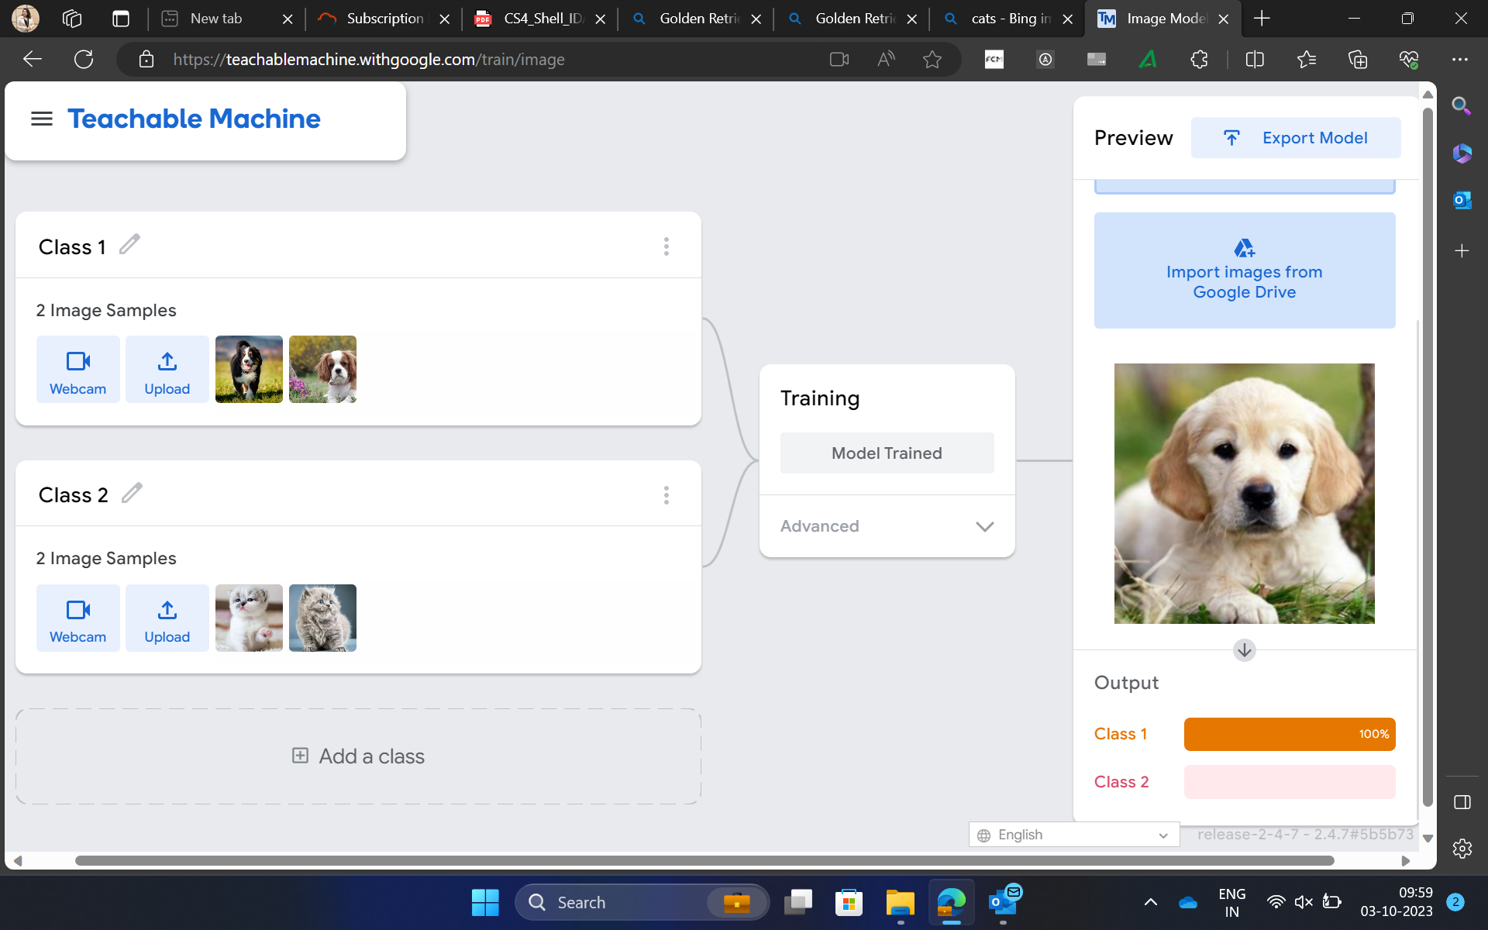
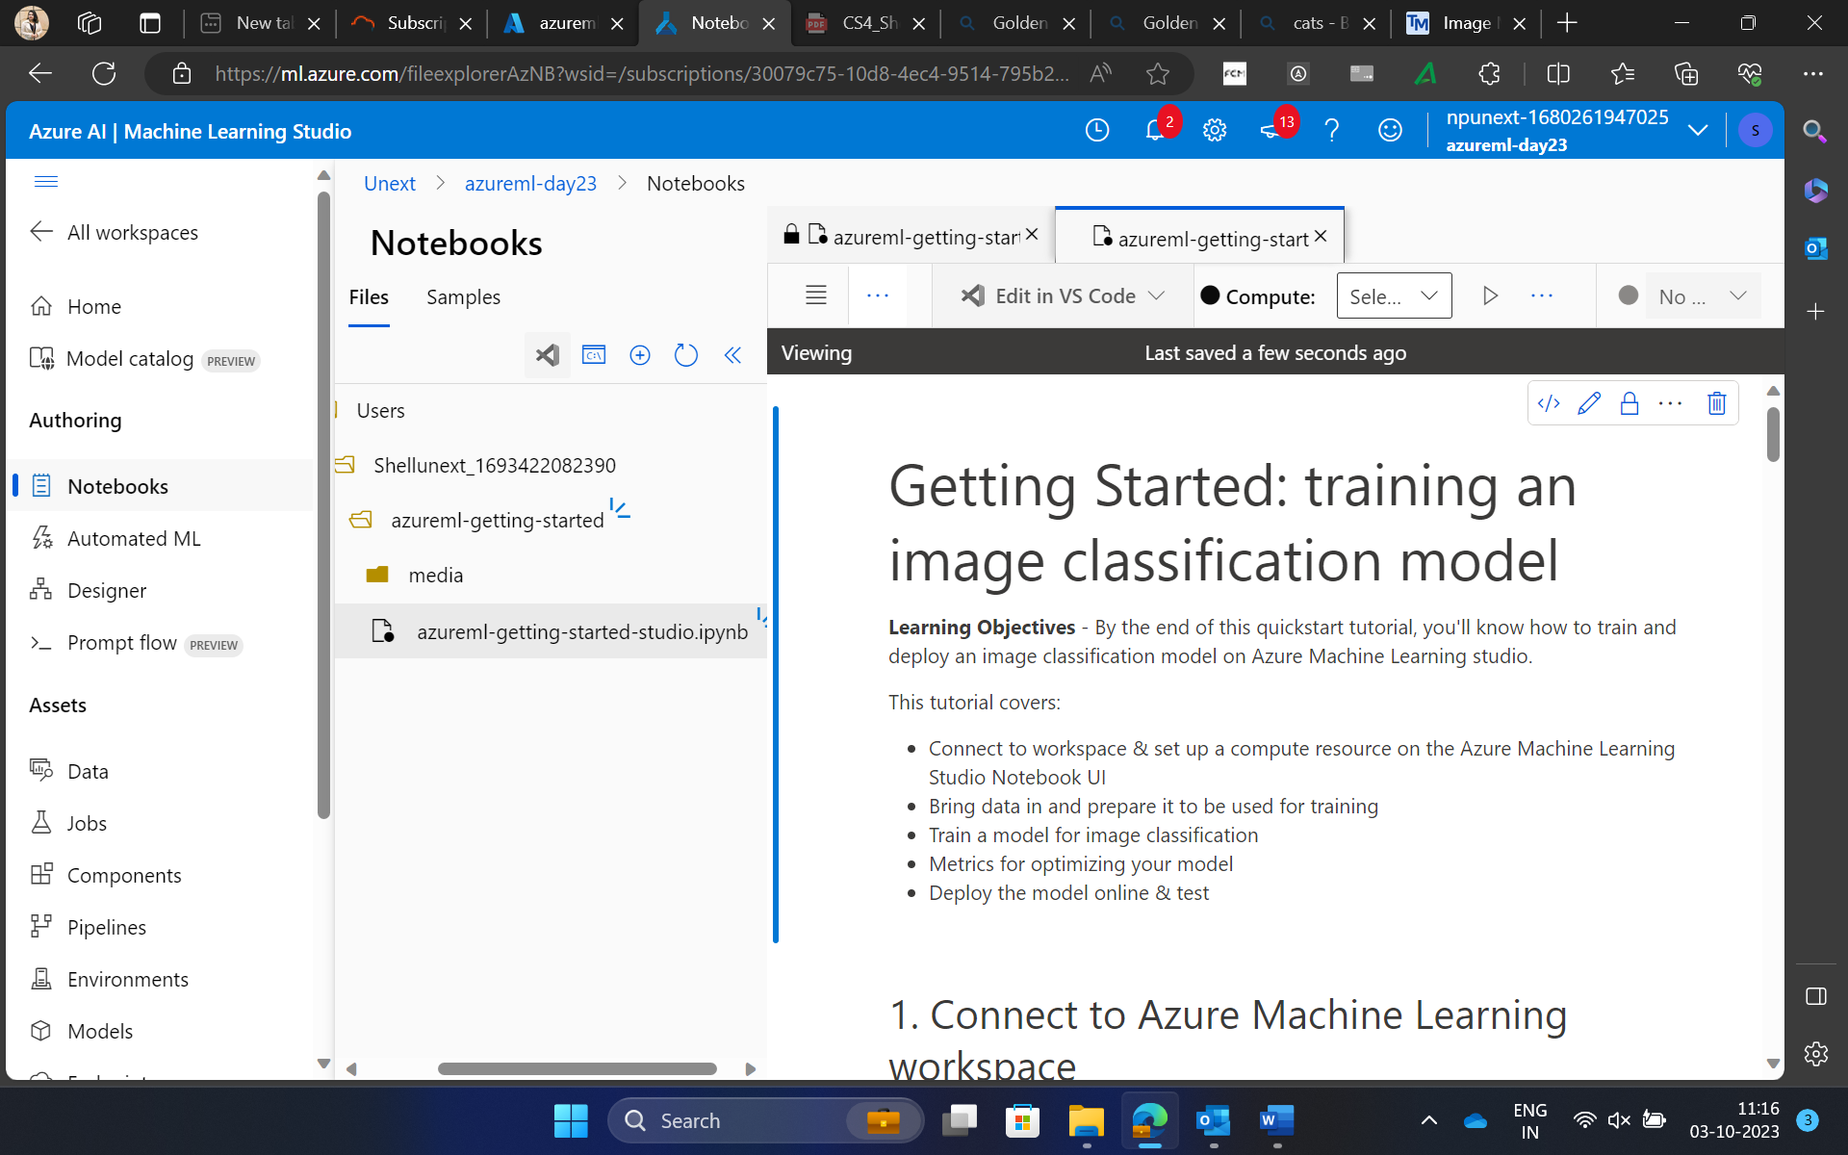
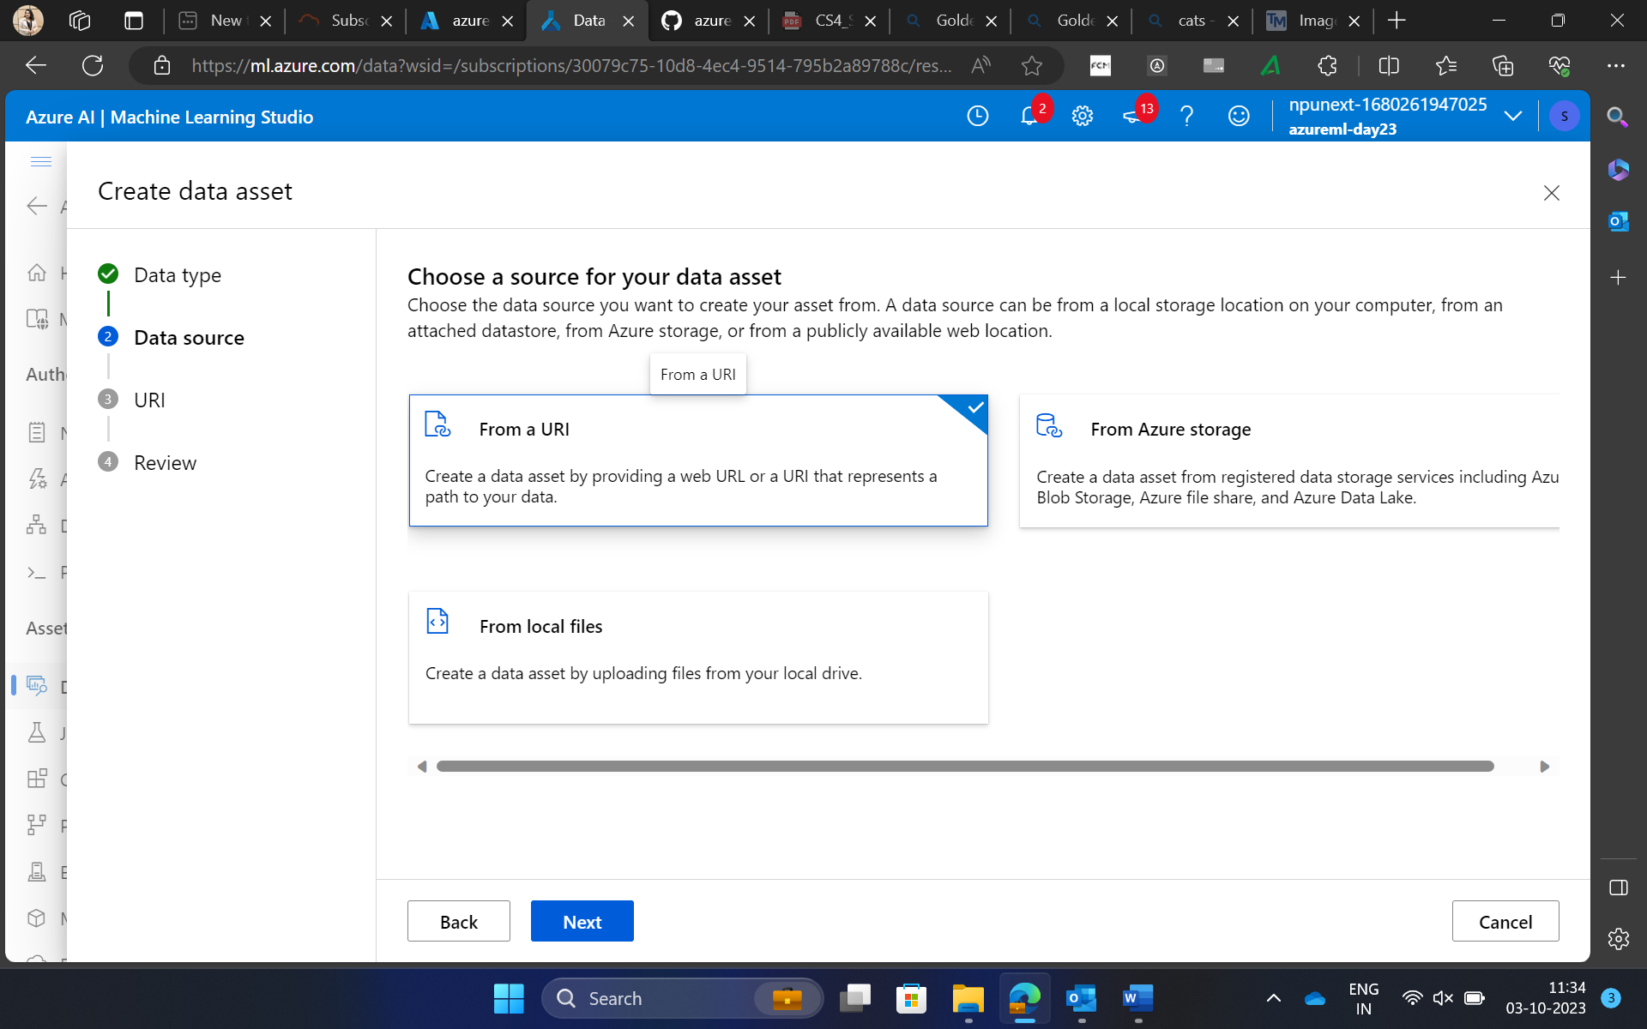
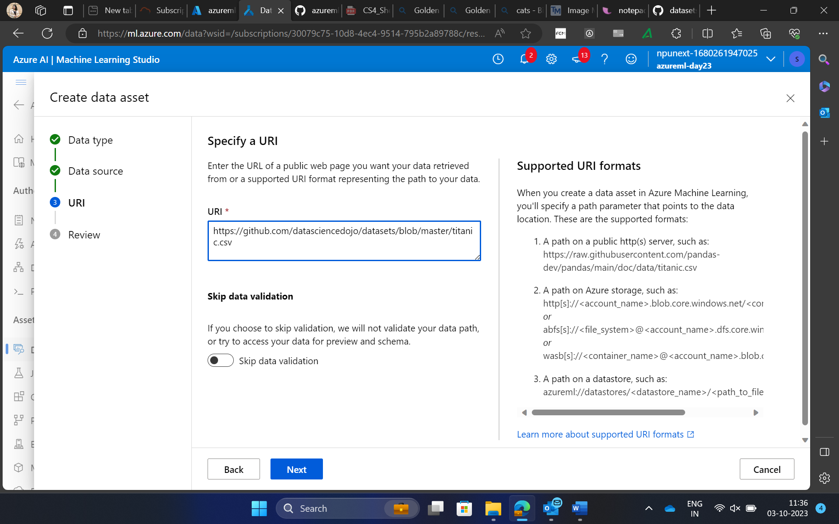

Slide 5
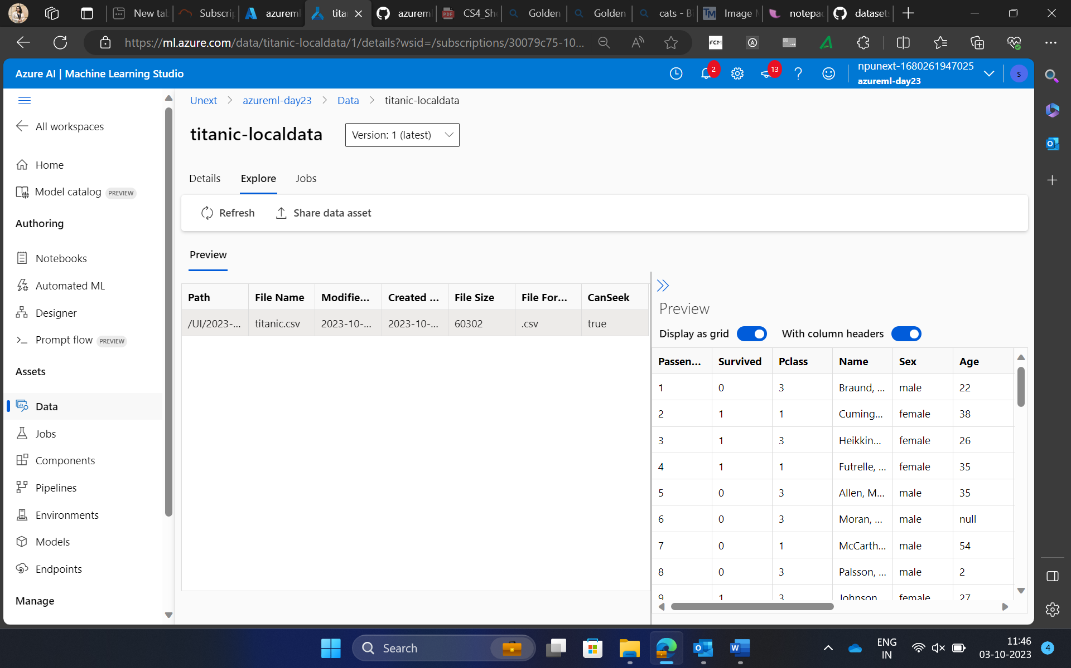
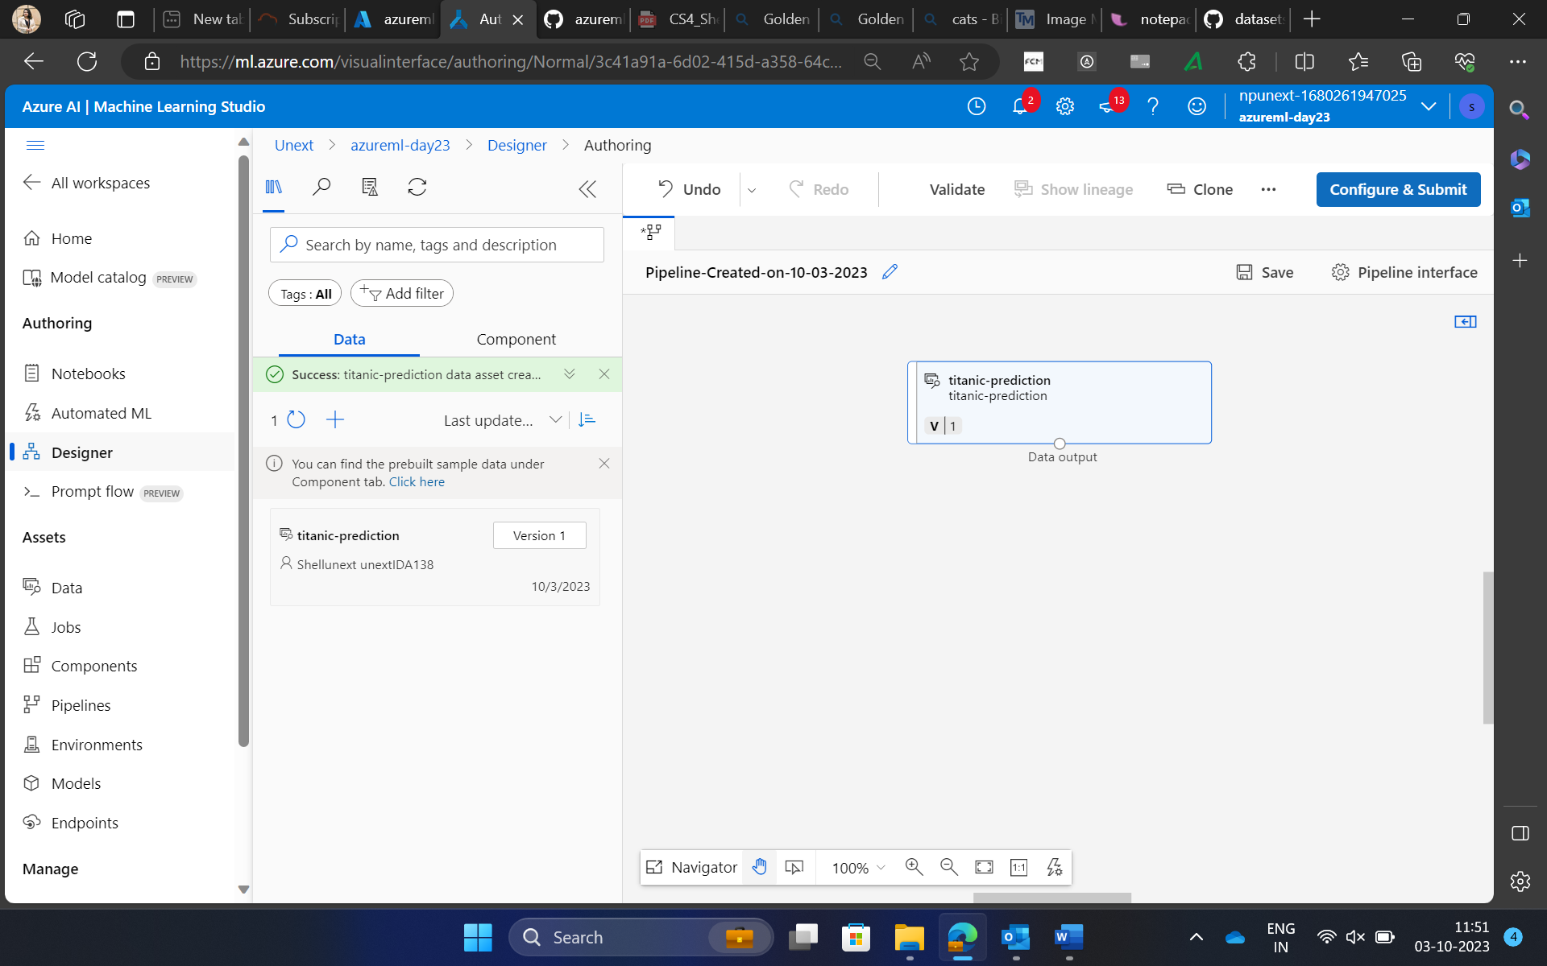
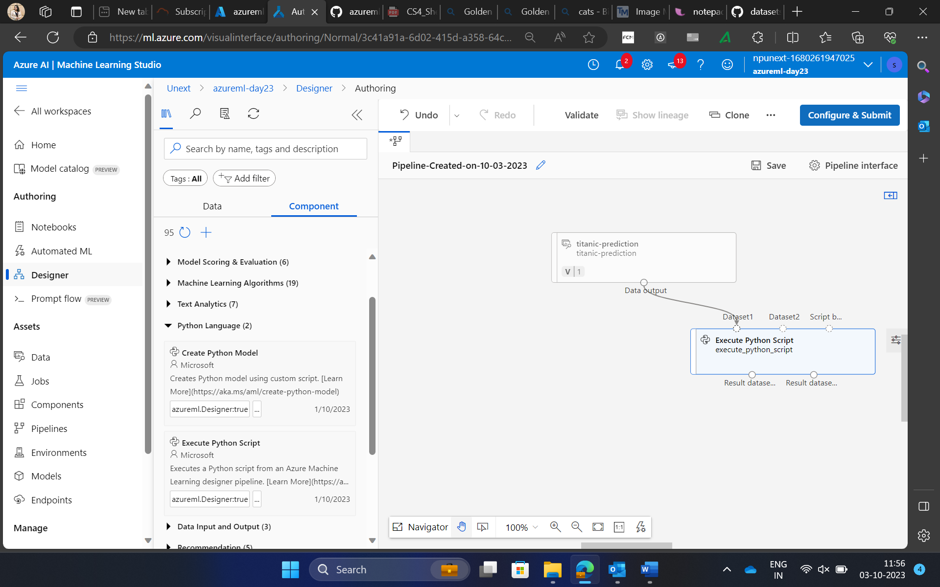
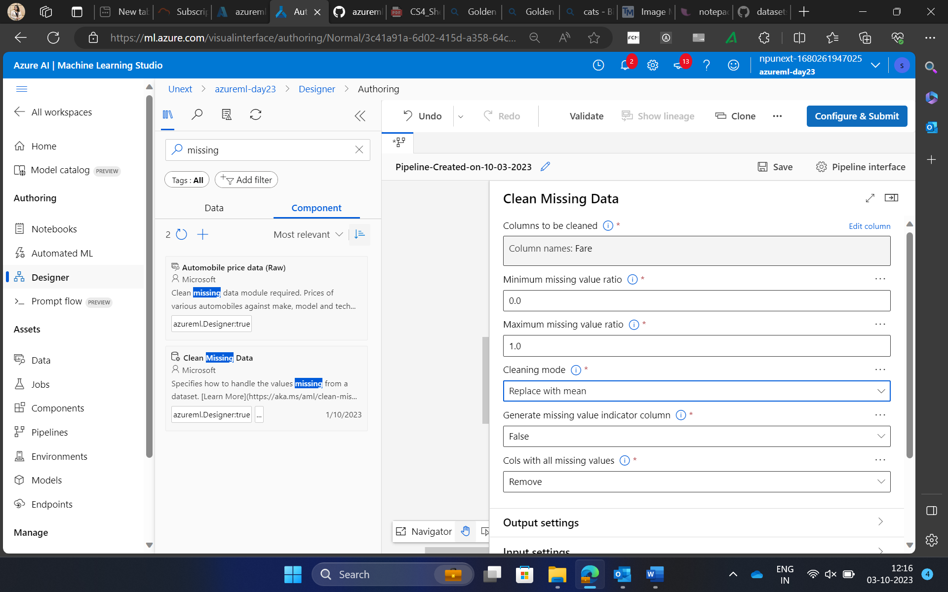

Slide 6
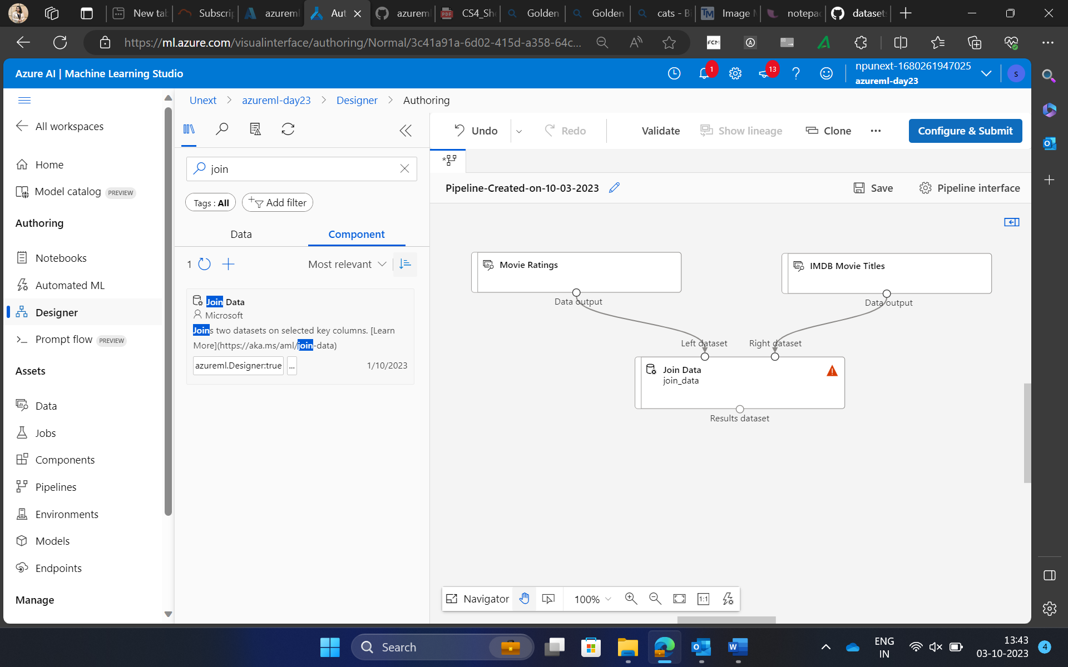
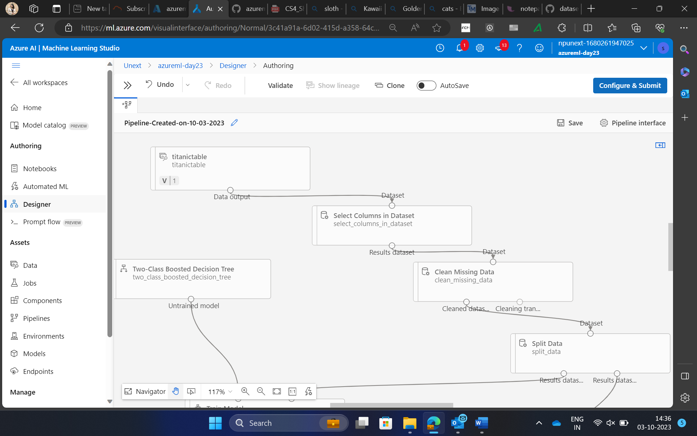
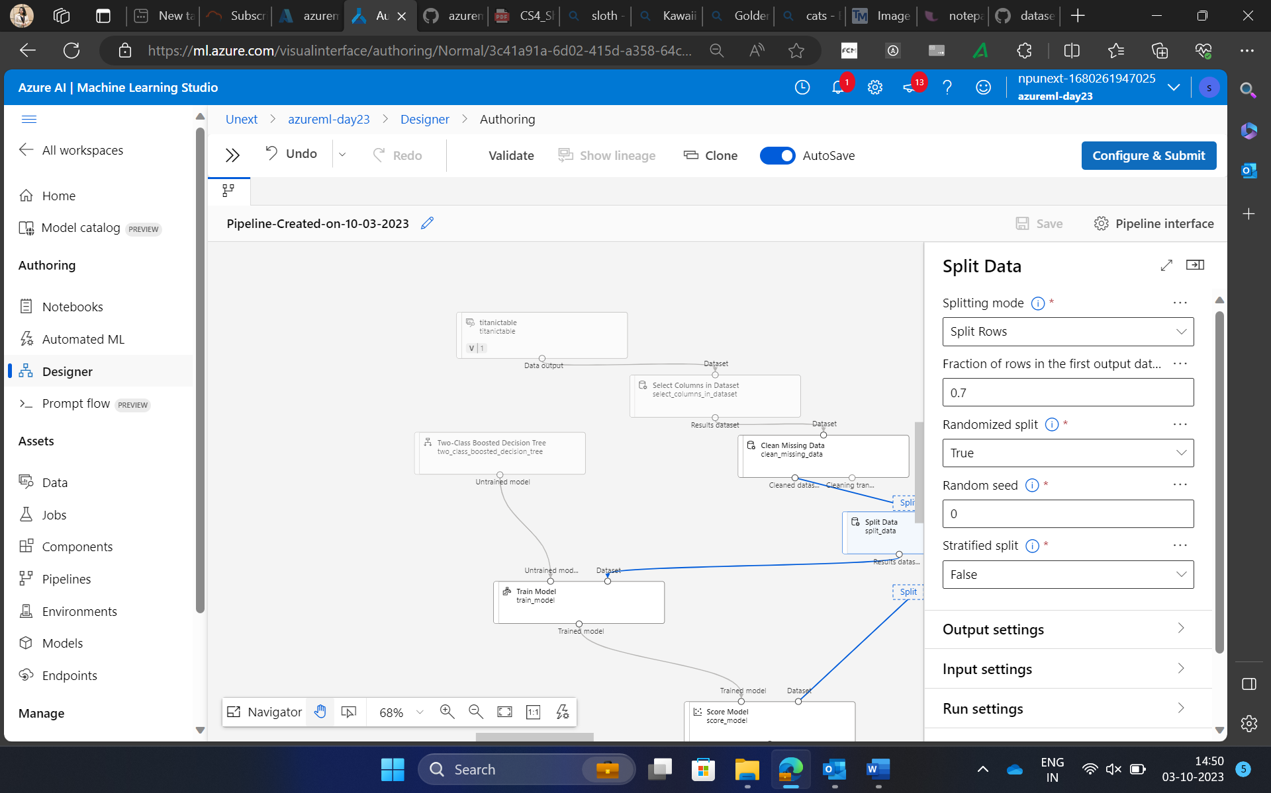

Slide 7
DAY 24: Azure ML Studio Day 2

Slide 8
Topics Covered
Create a Regression model with Azure ML designer
Creating and deploying models end to end
Data Structures – List, Tuple, Dictionary and Set
Building machine learning workflows using drag and drop interface
Designing and deploying models using AutoML

Slide 9
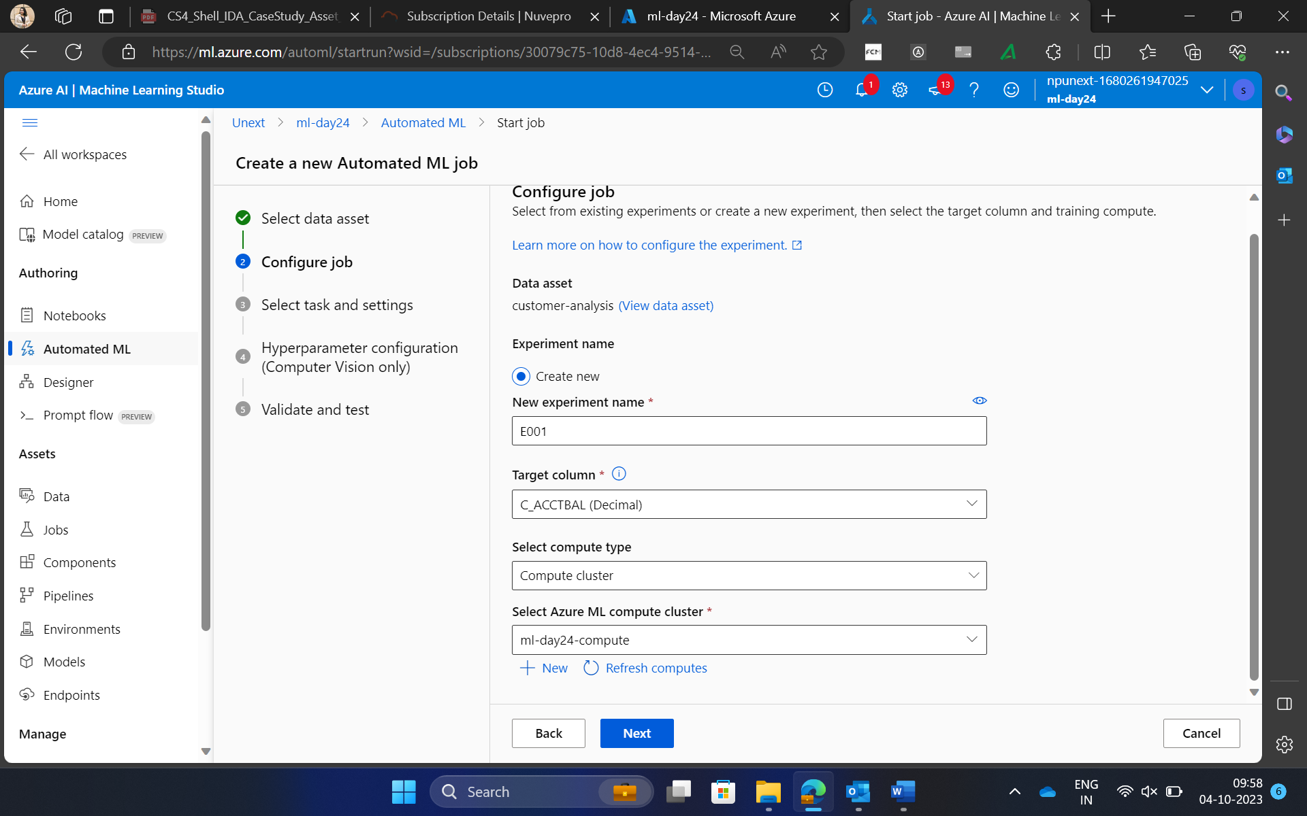
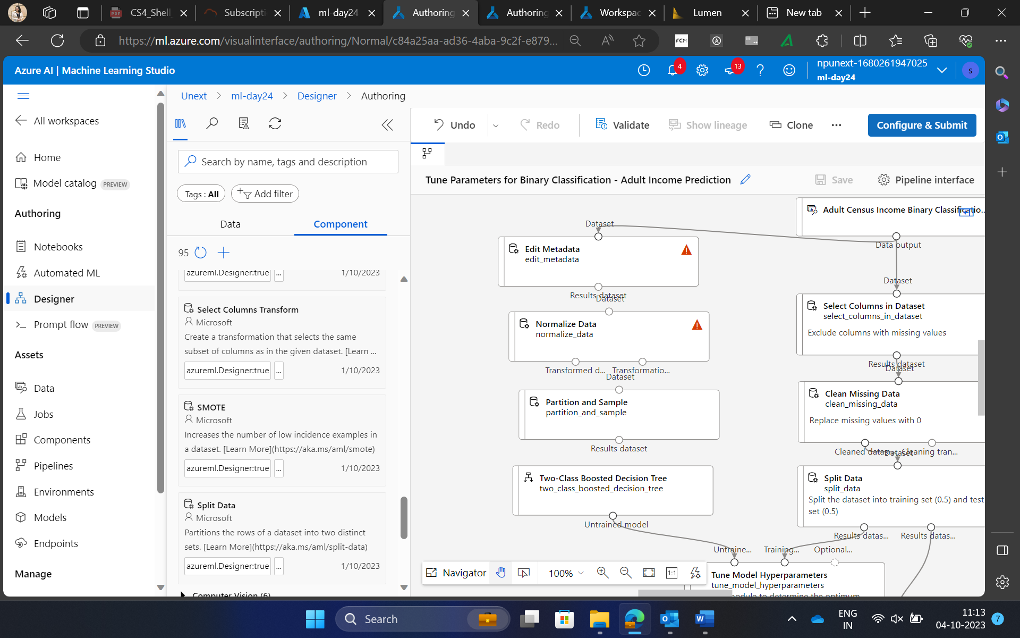
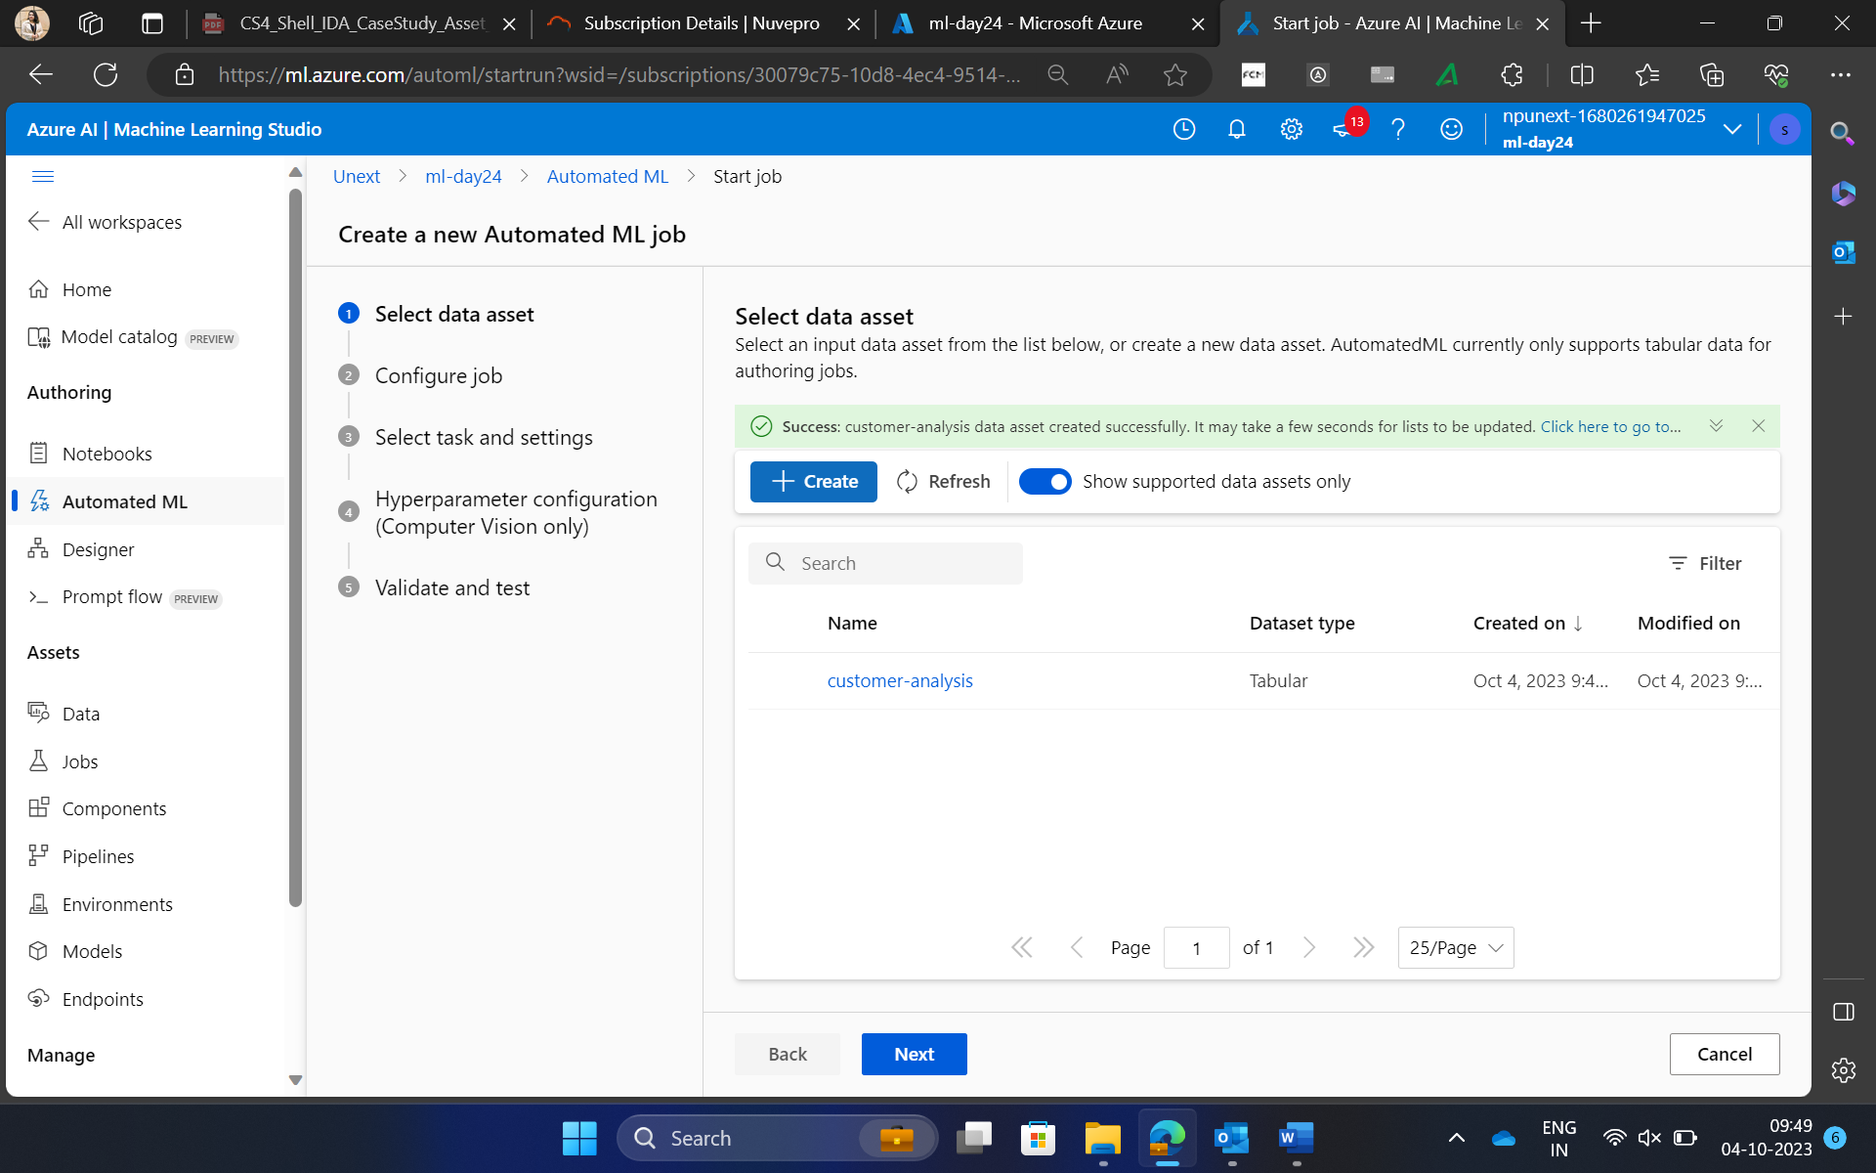

Slide 10
THANK YOU

